Slide 1
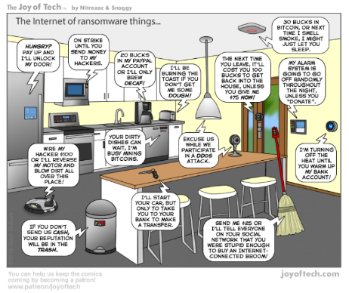
What’s cooking? Home Automation in your Kitchen
Lorain County Computer Users Group September 12, 2023

Slide 2
This presentation is brought to you by APCUG’s Speakers Bureau, a benefit of your group’s membership.
Judy Taylour
President, SCV Computer Club
APCUG Advisor, Regions 1, 5, 9, 10, and International
Member, APCUG Speakers Bureau
Jtaylour (at) apcug.org

Slide 3
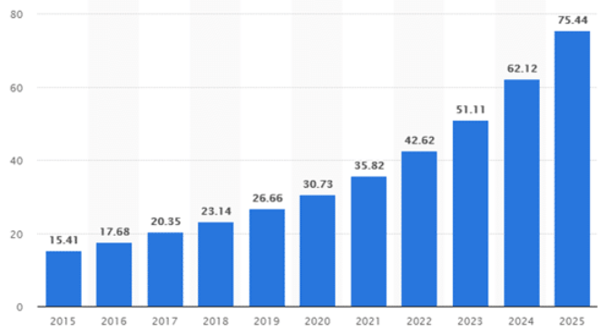
Smart home devices – 2015 - 2025
Increasing demand for these devices in the near future.
Numbers in the Billions.

Slide 4
Reasons for Home Automation
Connecting the tech in your home to your Wi-Fi network and each other has many benefits
Can control everything in real time
Either through a voice-controlled hub, your smartphone, or tablet
Makes your life easier, saves you time…..
Your home gets to know you and your family and automatically works based on what’s happening, without the need for your input.

Slide 5
Start with a Plan
What do you want to accomplish for your kitchen?
Smart lights
Smart appliances
Smart Gadgets
And much more
What is your plan?
What is your budget?

Slide 6
Start with a Plan
How much do you want to spend now?
In six months?
A year?
Rolling out your smart kitchen in stages helps spread out the cost

Slide 7
Amazon Echo vs. Google: Which smart speaker is best?
Google Assistant is more conversational
Often remembers what you were talking about or lets you carry ideas throughout a conversation
Alexa tends to be a stickler for wording and a particular sequence of words
Alexa leans heavily on Wikipedia for general knowledge questions
Google’s search is more comprehensive
Alexa beats Google in shopping-related questions – she really wants to help you buy things from Amazon

Slide 8
Amazon Echo vs. Google: Which smart speaker is best?
Both Assistants let you combine your devices into rooms
You can say things like “turn on the kitchen lights.”
Both support routines/skills which let you combine multiple actions into one command
Google Home has one big content advantage, it integrates with YouTube

Slide 9
Cooking with Google Assistant
Choose your recipe
“Hey Google, prepare the ingredients”
Assistant will start to read the ingredients
“Hey Google, next ingredients” to get more ingredients
Reads the instructions in individual steps or in clusters of three
Can ask your Assistant to repeat steps, set a timer, convert teaspoons to tablespoons…..

Slide 10
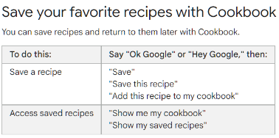
Cooking with Google Assistant
Ask your questions
"Find me a lasagna recipe“ - "I want to make banana bread“
"How do I cream sugar and butter?"
"Can I replace baking soda with baking powder?"
"How many does this serve?“
"How much is that in cups?“
Cook with your Google Assistant on your speaker or display - Google Nest Help
Listen to music on speakers and displays - Android - Google Nest Help

Slide 11
Cooking with Google Assistant
Enjoy your favorite cooking-inspired music
Free or pay
YouTube Music, Spotify Free, Pandora
Don't use the general command "Hey Google, next"
Use "Next song" (music)
"Next step" (cooking) to distinguish between the two actions
Tech with Brett (3) How to Cook With Google Home - YouTube

Slide 12
Cooking with Alexa.Cooking interface
Voice interaction model is already built for you.
Alexa, is the oven on?
Alexa, is the microwave running?
Alexa, stop the microwave.
Alexa, turn off the oven.
Alexa, set the oven to convection bake.
Alexa, defrost three pounds of meat in my microwave.
Enable announcements to notify you when the cooking appliance or the food needs attention.

Slide 13
Cooking with Alexa
Automate your gadgets
Look up recipes
Convert measurements
Adjust your smart appliances
Stream video tutorials
Add items to your grocery list
Listen to music
Track calories

Slide 14
Cooking with Alexa and the Food Network
Use Alexa to unlock live and on-demand cooking classes
Cook hands-free
Interact with expert chefs
Stream episodes of your favorite series
Interact with Allrecipes
How To Use the Food Network Kitchen App on Amazon Devices | FN Dish - Behind-the-Scenes, Food Trends, and Best Recipes : Food Network | Food Network
Alexa | Allrecipes

Slide 15
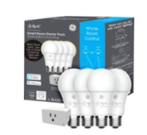
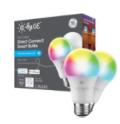
Let’s start with smart bulbs
We want to control them with our voice
C by GE bulbs
What to spend more money
Upgrade to Philips Hue bulbs

Slide 16
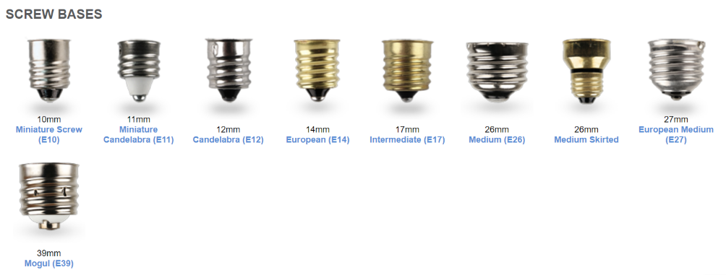
Smart Bulbs
Before you buy - check the base fittings
Many smart bulb manufacturers make a variety of different fittings

Slide 17
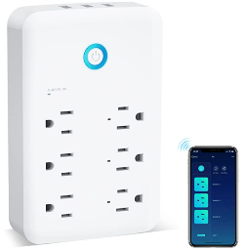
Smart Plug Outlet Extender - $16.99
Control your appliances with Wi-Fi
3 USB Ports, 6 Outlet Wall Adapter Plug Extender for App Control – FCC compliant – 2.5GHz
Works with Alexa and Google Home
Set up name of the appliance for each socket.
“Hi Google, turn on /off the whatever”
Makes your life more convenient
https://www.amazon.com/Smart-Extender-Protector-Adapter-Control/dp/B09JZCXQNY?th=1- - Amazon.com

Slide 18
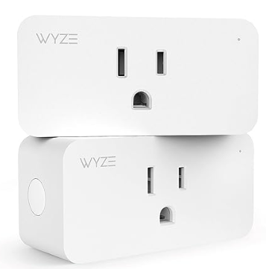
2.4GHz WiFi Smart Plug - $19.99/2 pack
Control your appliances with Wi-Fi and your voice
Works with Alexa & Google Home Assistant
Protect enable away mode and look like you're home even when you're not.
Schedule control and schedule lights and appliances from anywhere
Stack space-saving design won't cover the whole outlet
Wyze Plug, 2.4GHz WiFi Smart Plug, Works with Alexa, Google Assistant, IFTTT, No Hub Required, Two-Pack, White - Amazon.com

Slide 19
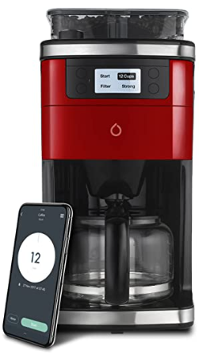
Smarter Smart iCoffee Brew Coffee Maker - $144.89
Wi-Fi Enabled: state-of-the-art remote brewing with Wi-Fi capability from any device using the SMARTER app
Can connect to Amazon Alexa, Google Assistant, Nest and more
Keeps coffee at desired temp for 40 minutes
Programable: Customize for your own brewing tastes and set alarms to have coffee ready whenever you want it, however strong you want it
Easy to Use: simple set up and pairing to multiple devices to add an additional resource to your smart home capabilities
Amazon.com: Smarter Smart iCoffee Brew Coffee Maker in Red with Built-in Grinder App for Customized Coffee On Demand : Home & Kitchen

Slide 20
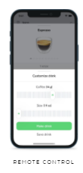
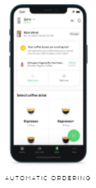
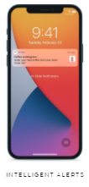
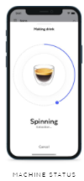
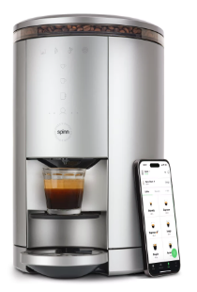
Spinn Smart Wi-Fi Coffee Maker - $799.99
World’s first bean-to-cup coffee maker that can make a single serve Espresso, Lungo, Americano, Carafe of Coffee …..
Coffee Maker & Coffee Beans Market Place - Spinn

Slide 21
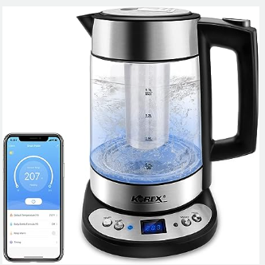
Smart Korex Electric Kettle - $85.99
Alexa and Google Assistant
Plus ‘Smartlife App’
Download from Amazon App Store or Google Play
Kettle automatically shuts off once the water has reached the selected temperature
Automatically shuts off when kettle is nearly empty
Amazon.com: Smart Electric Kettle APP Control, Korex Glass Water Boiler Included Filter Suitable for Alexa Google Home Assistant 1.7 L BPA FREE Great for Coffee Tea Milk With Overheat Protection Controlled by Smartphone: Home & Kitchen

Slide 22
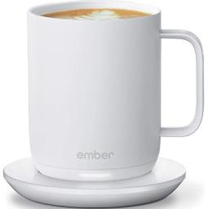
Ember Temperature Control Smart Mug - $129.95
Alexa & Google Assistant with Ember app
App-controlled to set the temperature of your coffee or drink of choice
Remembers last preferred drinking temperature
Wakes up when hot liquid poured in and sleeps when empty
80 min. battery Life
Sleep mode after two hours of inactivity or an empty mug
Amazon.com | Ember Temperature Control Smart Cup, 6 oz, App-Controlled Heated Coffee Cup, Espresso Mug with 90 Min Battery Life, Black: Espresso Cups

Slide 23
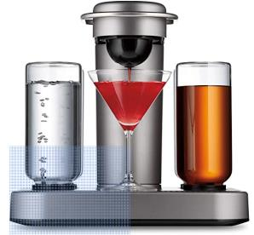
Intelligent Cocktail Creation- $369.99
Bartesian Premium Cocktail and Margarita Machine for the Home Bar
Mixologist-approved drinks with your favorite whiskey, vodka, rum, gin or tequila
Insert a cocktail capsule, select your preferred strength and press mix
Cleans itself after each cocktail is created
Amazon.com: Bartesian Premium Cocktail and Margarita Machine for the Home Bar with Push-Button Simplicity and an Easy to Clean Design (55300) : Grocery & Gourmet Food

Slide 24
Umbra Otto Automatic Soap Dispenser - $39.99
Touchless, Hands Free Pump for Kitchen or Bathroom
8.5 oz liquid hand soap, dish soap or sanitizer dispenser
Dispenses soap or sanitizer in 0.2 seconds
Amazon.com: Umbra Otto Automatic Soap Dispenser Touchless, Hands Free Pump for Kitchen or Bathroom, Regular, White/Gray : Home & Kitchen

Slide 25
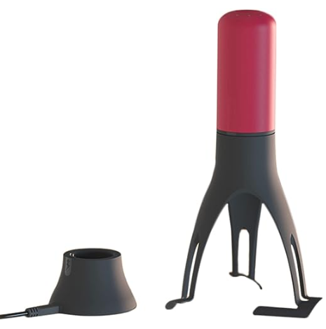
Uutensil Stirr Automatic Pan Stirrer - $41.50
Rechargeable automatic stirrer
LED lights to indicate speed
Self-rotating with three-speed options
USB charging stand
Amazon.com: Uutensil Stirr - The Unique Automatic Pan Stirrer - With LED Speed Indicator, Red: Home & Kitchen

Slide 26
Out of Milk Grocery Shopping List App
Manage lists hands-free – Google Home and Alexa
Use your voice to add items to your list as you put them in your trash can
Shopping List, Pantry List & To-Do List in a small, intuitive and easy-to-use app.
Shopping List stays with you everywhere you go
Pantry List allows you to keep track of your pantry items (spices, essentials, etc...)
To-Do list helps you keep track of any other items on your daily list.
Out of Milk – The Grocery Shopping List App

Slide 27
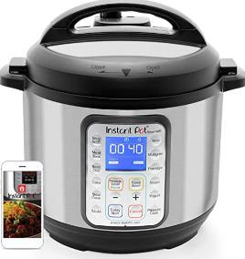
Instant Pot Smart Wi-fi 6 Quart … $149.99
8 in 1 kitchen appliances -- pressure, slow, and rice cooker; yogurt and cake, sauté pan, steamer, and warmer
Compatible with Alexa
Verify cooking progress
Share cooker access with family
Receive alerts on your mobile device
Amazon.com: Instant Pot Smart Wifi 6 Quart Multi-use Electric Pressure, Slow, Rice Cooker, Yogurt, Cake Maker, Sauté, Steamer and Warmer, Silver: Home & Kitchen

Slide 28
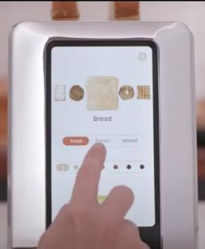
Revolution InstaGLO™ R180 Toaster - $349.95
60+ digital settings
Choose bread, bagel, waffle, English muffin or toaster pastry
Smart sensors customize the heating process based on bread type, voltage level and toaster's temperature
Manual reheat warms up toast in 15 seconds
Defrost setting adjusts cook times for frozen items
Amazon.com: Revolution InstaGLO™ R180 Toaster. 2-Slice, High-End Stainless Steel Design. Features Touchscreen with 60+ High-Speed Smart Settings for Perfectly Toasted Bagels, English Muffins, Toast, Pop-Tarts and much more: Home & Kitchen

Slide 29
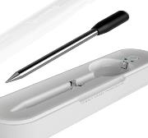
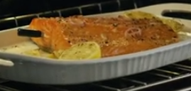
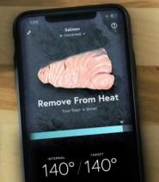
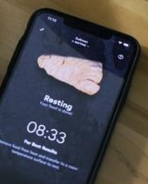
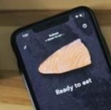
Yummly Smart Thermometer - $79.99
iOS and Android
Thermometer can track two temperatures at once
Use with B-B-Q grill, smoker, and air fryer
Works at a range of up to 150 feet
25+ hours of continuous use between charges
Yummly Smart Meat Thermometer with Wireless Bluetooth Connectivity (amazon.com)

Slide 30
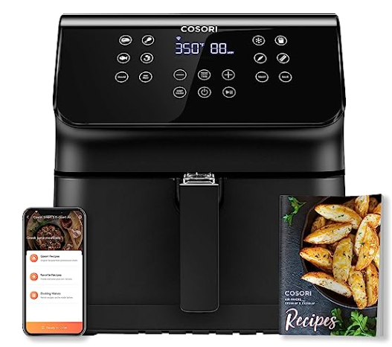
COSORI Smart Wi-Fi Air Fryer - $139.99
Relax on your couch VeSync notifications
Three ways to control
Directly from the display
Remotely through the VeSync app
With Alexa and Google’s Assistant
Mark your favorite recipes
View your recipe history
Create and save your own custom recipes
Amazon.com: COSORI Smart WiFi Air Fryer(100 Recipes), 13 Cooking Functions, Keep Warm & Preheat & Shake Remind, Works with Alexa & Google Assistant, 5.8 QT, Black : Home & Kitchen

Slide 31
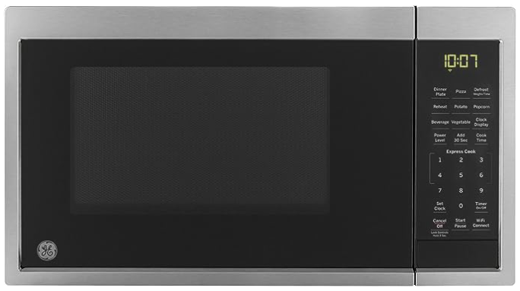
GE Countertop Microwave Oven… $159.99
0.9 cubic feet / 900 watts
Works with Google Assistant and Alexa
Use your voice to operate your microwave from any room in the house
Scan-to-cook technology with manufacturer’s bar code
Amazon.com: GE JES1097SMSS Countertop Microwave Oven | Complete with Scan-to-Cook Technology and Wifi-Connectivity | 0.9 Cubic Feet Capacity, 900 Watts | Smart Home & Kitchen Essentials Cu Ft, Stainless Steel : Home & Kitchen

Slide 32
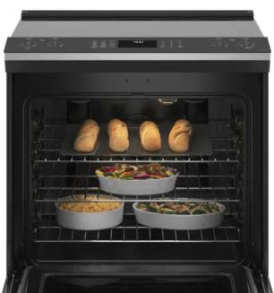
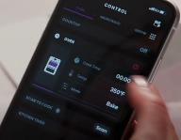
GE Profile™ 30” Electric Range - $1,598.00
Profile Connect Series– built-in Wi-Fi
Can control oven functions with the SmartHQ app on your smart device
No reheat air fry
Self-cleaning
Pre-heat your oven on the way home
Make sure you turned off your burners
GE Profile 5.3 cu. ft. Electric Range with Steam-Cleaning Convection Oven and Air Fry in Stainless Steel-PSS93YPFS - The Home Depot
https://www.youtube.com/watch?v=rzWHknDt-Ck

Slide 33
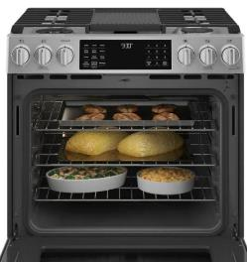
GE Profile™ 30” Gas Range - $3,058.00
Wi-Fi convention oven
No hub required
Synchronize clocks and lights with Chef Connect
True convection with advanced air
Dual fuel - gas cooktop and electric oven with hidden bake
Precision temperature probe
GE Profile 5.7 cu. ft. Slide-In Dual Fuel Range with Self-Cleaning Convection Oven in Fingerprint Resistant Stainless Steel-P2S930YPFS - The Home Depot

Slide 34
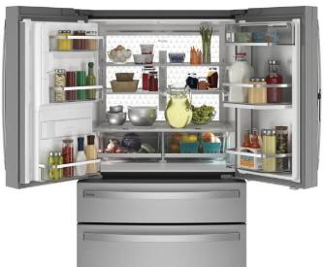
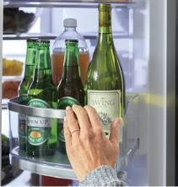
GE Profile™ Refrigerator- $2,998.00
27.9 cubic feet – 4 doors
Door-in-door revolving door
Soft-close drawers
Entire back wall of LEDs illuminate your entire refrigerator with crisp, white light
Leave a door open? Your smart device will notify you
GE Profile 27.9 cu. ft. Smart 4-Door French Door Refrigerator with Door in Door in Fingerprint Resistant Stainless Steel-PVD28BYNFS - The Home Depot

Slide 35
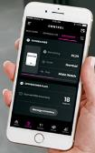
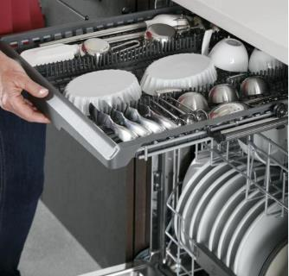
GE Profile™ Dishwasher - $1,394.00
24” top control - 3 racks – room for 16 place settings
Piranha hard food disposer - stainless steel blade rotates at 3,600 RPM
Steam and Sani - reduces 99.999% of bacteria
9 dBA - ultra-quiet
Wi-Fi connect
Monitor cycle status, check rinse aid levels and automatically reorder detergent using your mobile device
GE Profile 24 in. Stainless Steel Top Control Smart Built-In Tall Tub Dishwasher with 3rd Rack and Ultra Quiet 39 dBA-PDT785SYNFS - The Home Depot

Slide 36
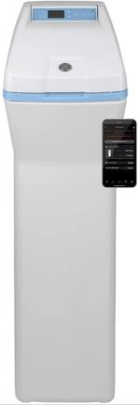
GE Water Softener - $699.00
Use up to 50% less dishwasher detergent and enjoy cleaner dishes with fewer spots
Reduces scale and build up in water heaters
Use Wi-Fi to monitor water usage and flow rate
Receive a notification when salt levels are low
GE GXSHC40N Water Softener, 40,000 Grain (Smart Home), Gray - - Amazon.com

Slide 37
Clean your kitchen – Wyze Robot Vacuum - $299.39
Room mapping
Path planning
Sensor groups including Laser Distance Sensor (LIDAR)
Area selection, scheduling, and virtual walls in Wyze App
The LIDAR sensor is a spinning laser on top of the vacuum. Every second, it spins around 6 times and measures the distance to 2,016 different points in the room to build a map. You can see, edit, and save the map in the Wyze app.
Wyze Robot Vacuum | Affordable Robotic, Automatic Vacuum with LIDAR – Wyze Labs, Inc -

Slide 38
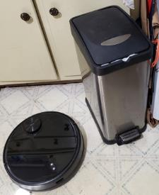
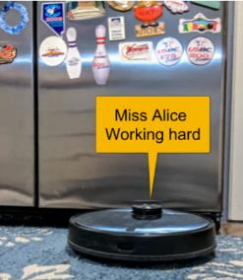
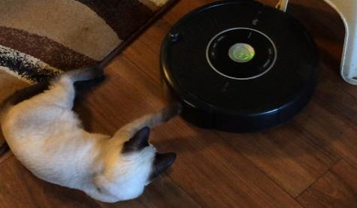
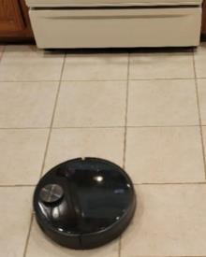
Meet the robot vacuums
Lives in SoCal
Lives in New Mexico
Rosie lives in Illinois
Herman lives in Oklahoma

Slide 39
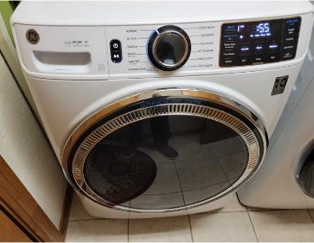
GE Smart Washing Machine - $898.99
Meet Sudsy
Alexa & Hey Google
SmartDispense Technology
Start, stop and monitor your laundry from anywhere
GE 4.8 Cu Ft High-Efficiency Stackable Smart Front Load Washer w/UltraFresh Vent, Microban Antimicrobial & SmartDispense Satin Nickel GFW650SPNSN - Best Buy

Slide 40
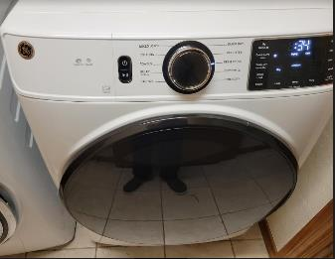
GE Smart Electric Dryer - $899.99
Meet Bounce
Alexa & Hey Google
Signals when clothes are correct dampness for ironing
Alert when something is stuck in vent
Wrinkle care – extends tumble without heat
GE Profile 7.4 cu. ft. Smart White Electric Dryer with Sanitize Cycle and Sensor Dry, ENERGY STAR PTD60EBSRWS - The Home Depot

Slide 41
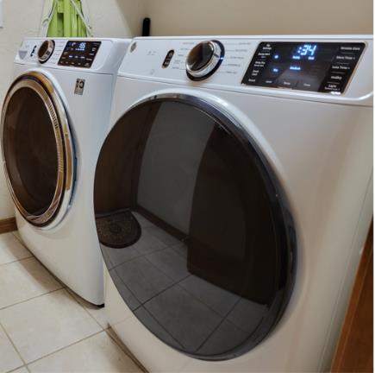
Sudsy & Bounce at Bill’s house
The happy duo live next to the kitchen

Slide 42
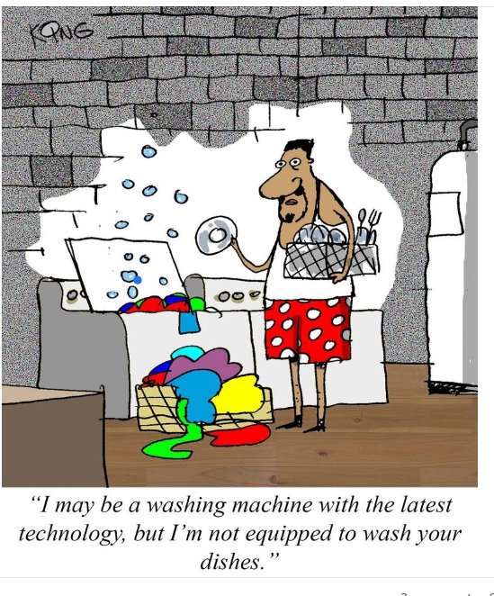

Slide 43
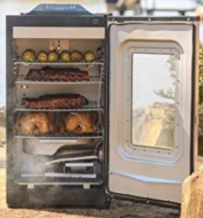
Masterbuilt Bluetooth Digital Electric Smoker with Broiler - $388.88
Bluetooth Smart technology allows you to
Control temperature Lighting
Monitor meat temperature
Power smoker on or off
Amazon.com : Masterbuilt MB20073519 Bluetooth Digital Electric Smoker with Broiler, 30 inch, Black : Patio, Lawn & Garden

Slide 44
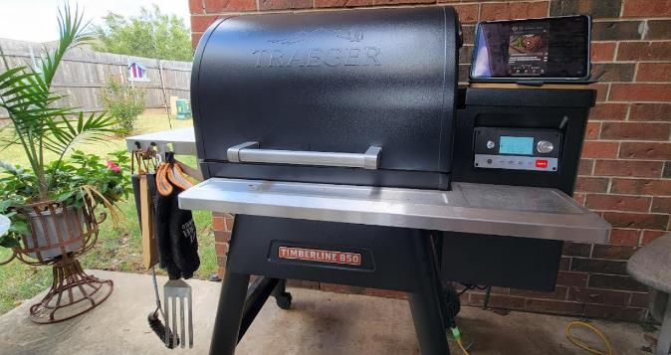
Take your kitchen outside – Traeger Wood Pellet Grill - $1599.95
Mr. Smokey

Slide 45
Standalone Wi-Fi appliances
Selecting devices by different manufacturers might require multiple apps to control everything.
Unfortunately, the standards for many devices do not work together.
Networks created with many different devices leaves you with many vulnerabilities that can possibly bring your system down.

Slide 46
Routers are the key to your security
Most Internet of Things (IoT) devices connect to the Internet through ‘Wi-Fi’ or ‘wired ethernet’ connection via a router
Routers have ‘built-in firewalls’ to minimize intrusion
Rename your router
Change default username and password
Use a strong, unique password or passphrase
Use strong encryption for Wi-Fi – at least WPA2

Slide 47
Routers are the key to your security
Keep your network router software / firmware up to date
Reboot it regularly
Use a separate Wi-Fi network for your devices
Set up and use a guest network if your Wi-Fi router supports it

Slide 48
Security
Read and understand privacy policies
Change default privacy and security settings, as necessary
Turn on two-factor authentication for your device accounts
Worried about Alexa and your Google Assistant listening to you?
Turn them off

Slide 49
Graphics from
Amazon
Home Depot
Spinn
Wyze
https://www.housebeautiful.com/shopping/home-gadgets/g22826031/smart-kitchen-appliances/
The Joy of Tech cartoons

